Slide 1
Reflecting Real-time monitoring of Agricultural Equipment in RBK

Slide 2
abstract
The Rythu Bharosa Kendra (RBK) is an initiative established by the government of Andhra Pradesh to support farmers by providing them with quality inputs, like seeds, fertilizers, pesticides and farm supplements. These inputs play a role in enhancing crop productivity and reducing cultivation costs. Additionally, RBK offers extension advisories at the village level. Currently all the information related to these services is managed using pen and paper. This project proposes an automated system that directly stores data into a database processes facility transactions and generates a report on the status of provided services. The real time location and status of RBK vehicles carrying these facilities can be tracked through a user interface developed using React technology. By equipping RBK vehicles with GPS devices and connecting them to a control center utilizing geo location concepts administrators can gain insights, into vehicle movements, route efficiency and potential delays.

Slide 3
Introduction
This approach that helps farmers from buying seeds to selling the crop, is called “Rythu Bharosa Kendra” (RBK). RBK’s were first launched in the state of Andhra Pradesh in October 2019. It integrates all the requirements of the farmers, like Agri labs, seed distribution and many more. Many departments are under RBK which work for the welfare of the farmers, like Integrated call centres (ICC) which provide solutions to farmers on, calls, Custom Hiring Centres (CHC) which provide machinery, to the farmers, such as sprayers, tractors and other farm supplements. Around 10,778 RBK’s have been established for assisting farmers in key areas. RBKs Community Hiring Centres (CHC) provide farmers with farm equipment such as tractors and sprayers based on the size of their land. However, there is currently no tracking system in place to confirm if the desired work has been completed. This causes confusion among CHC members. Additionally, manually monitoring the tractors once they arrive at the CHC does not provide any insights to the members or the Kisan group. Therefore, it is important to implement a system that automates user details entry into databases, for monitoring and confirmation of equipment reach

Slide 4
Problem statement
Rythu Bharosa Kendram face a lot of problem while storing data of the user and also while tracking the Agricultural inputs that are given to the farmers on lease. A proper system to store and manage the Data of the farmers and to monitor the inputs that are leaving the Rythu Bharosa Kendra should be proposed.

Slide 5
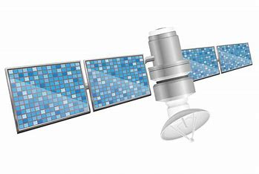
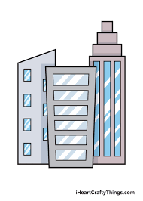
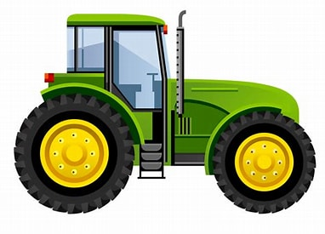

Proposed solution
satellite
Tractors containing GPS trackers
Web Application
Network center

Slide 6
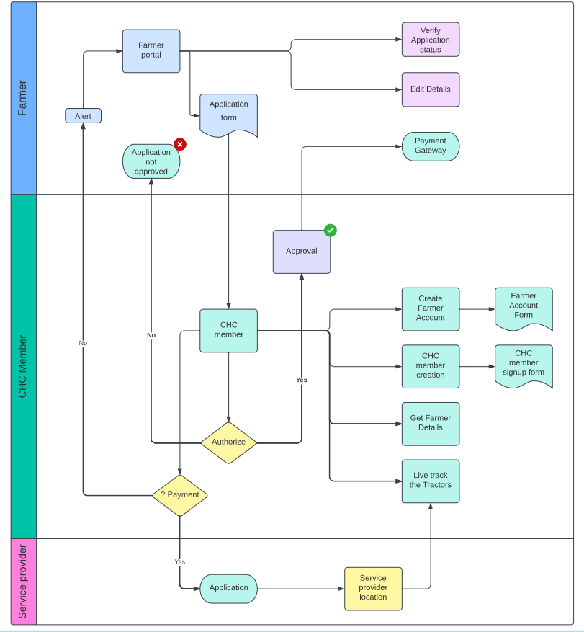
Uml design of proposed solution

Slide 7
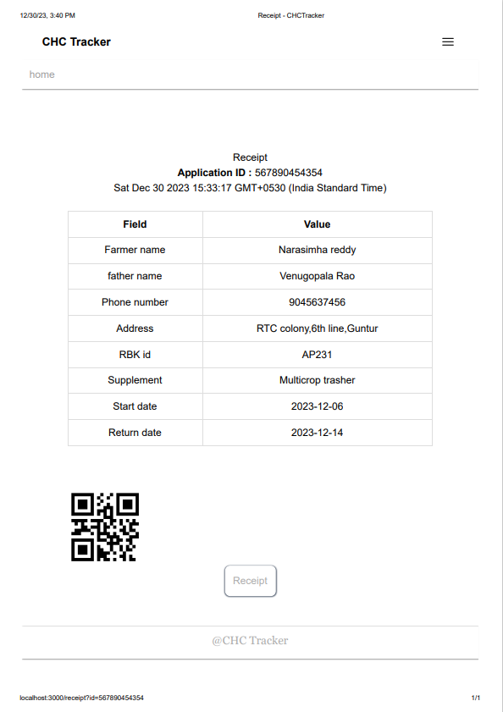
outputs

Slide 8
Thank you

